Slide 1


Moffat Bay Lodge
Bellevue University
CSD 460

Slide 2
Team
Tanner Agnew
Lead
Backend Developer
Emanuel Pagan
Backend Developer
Jessica Cheetham
Frontend Developer
Darius Dinkins
Frontend Developer

Slide 3
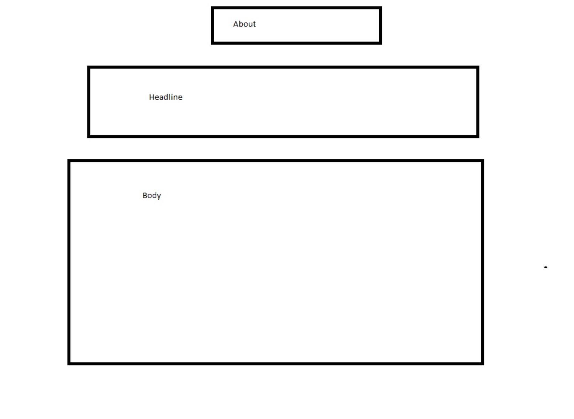
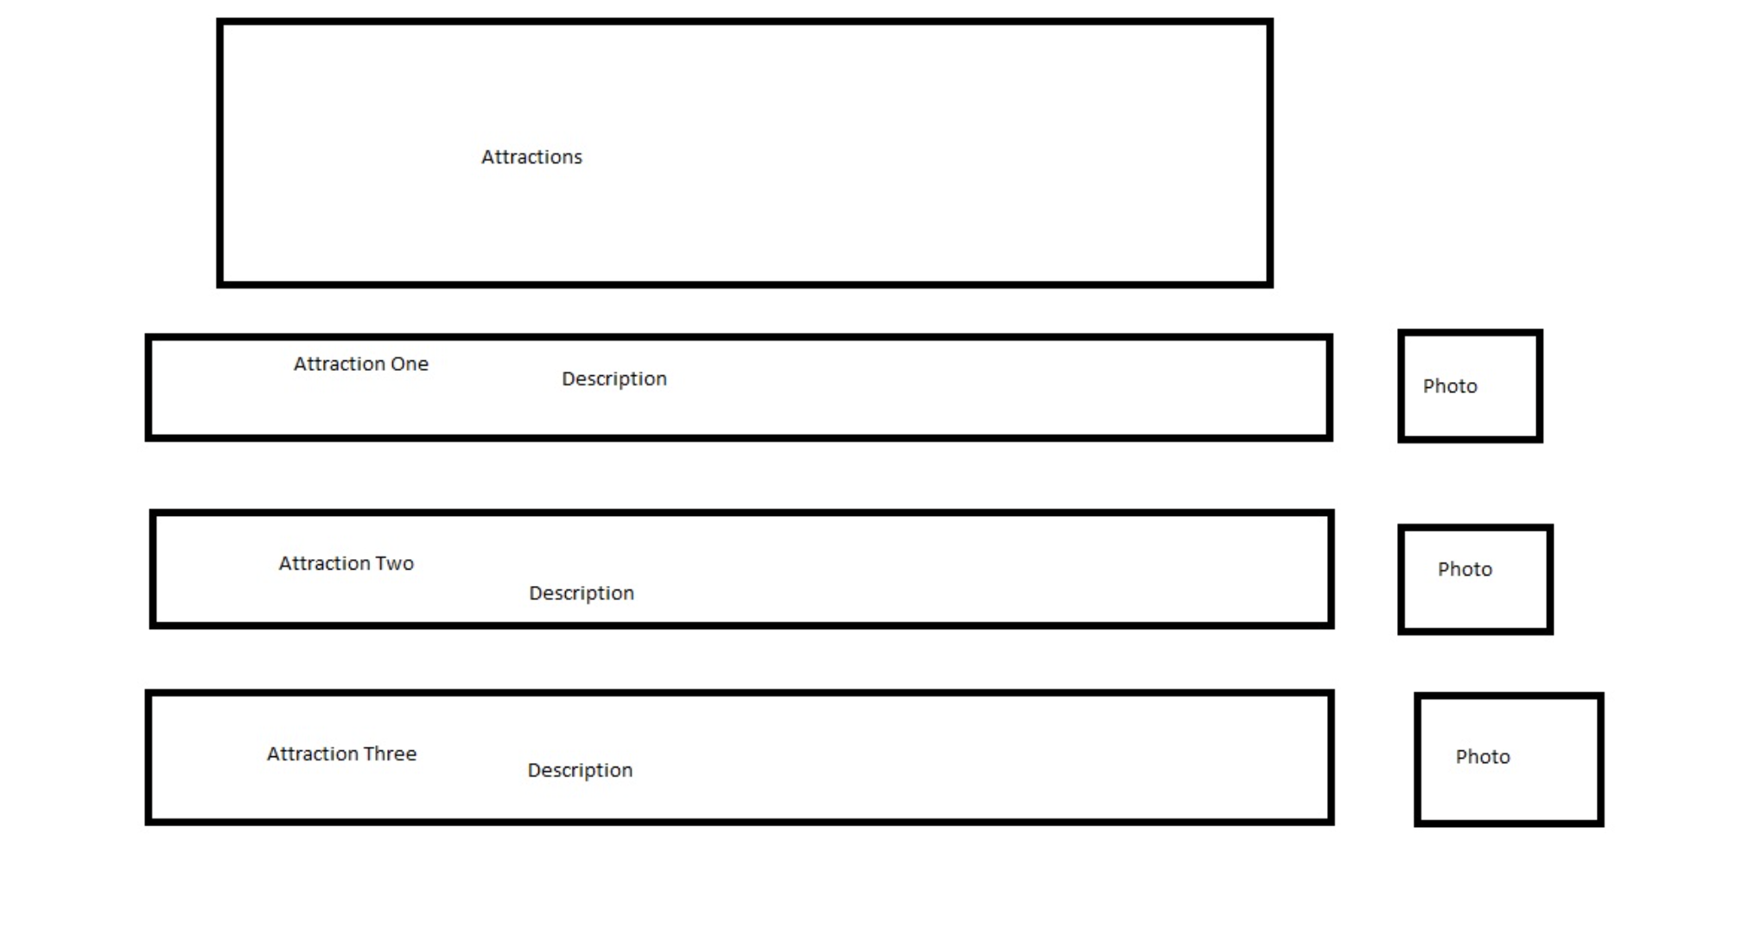
Sample Prototypes

Slide 4
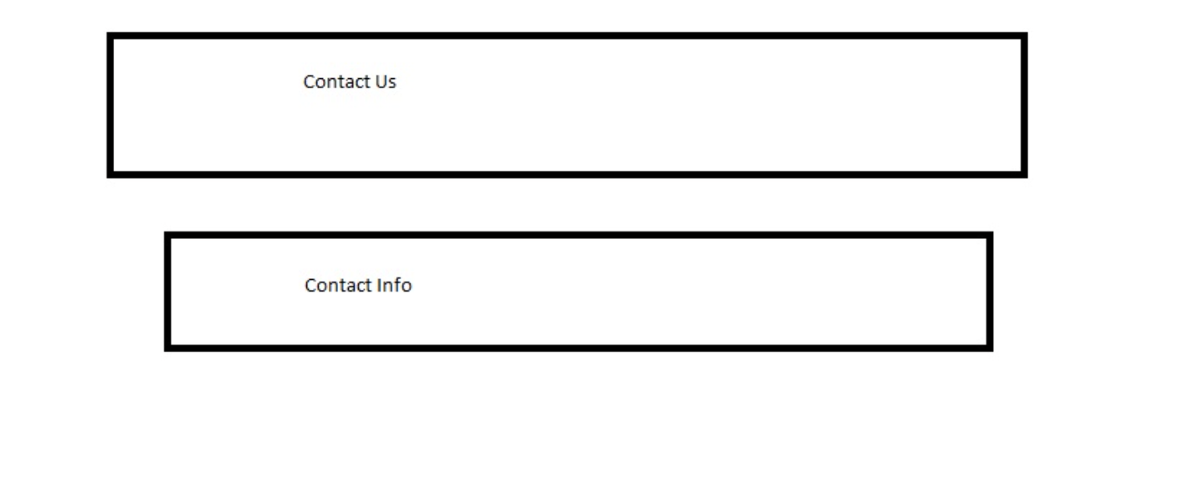
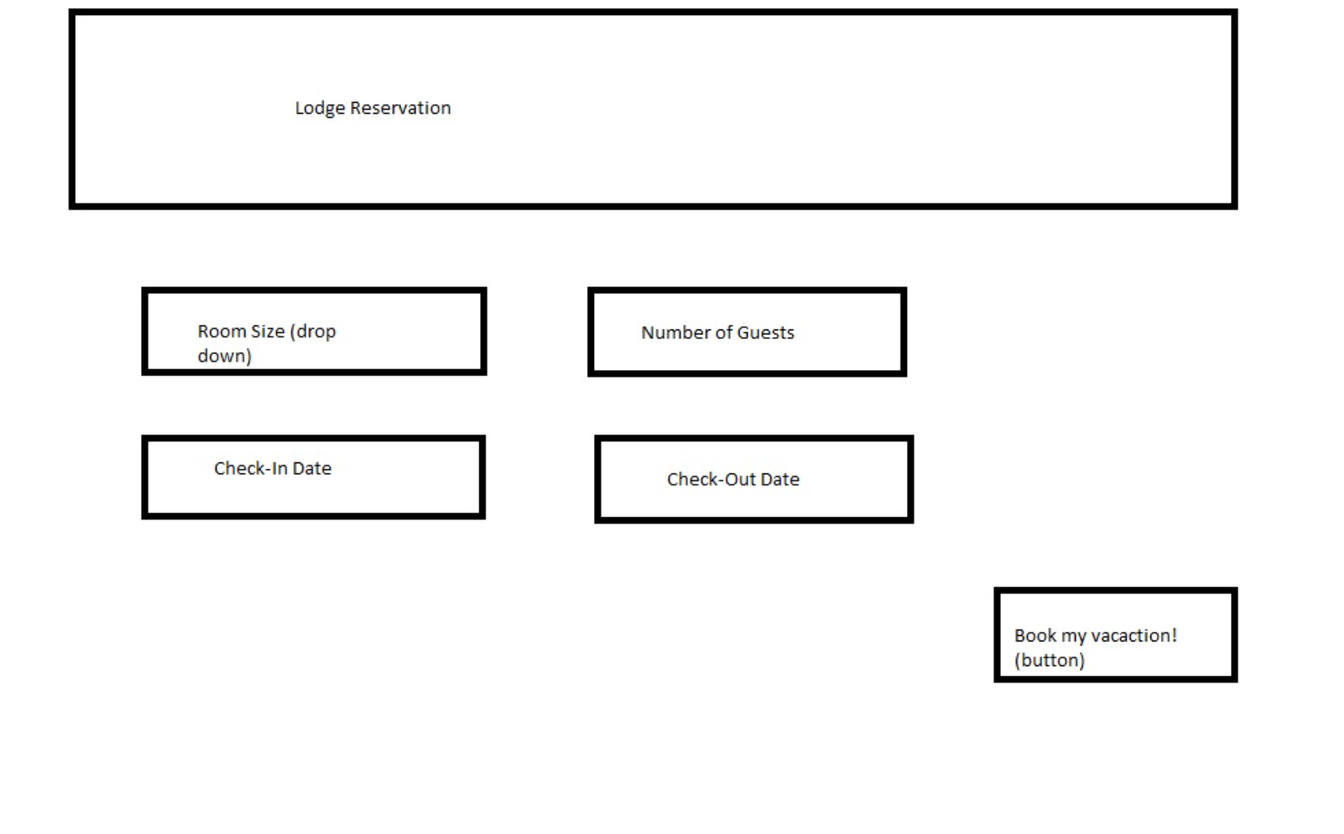
Sample prototypes (cont.)

Slide 5
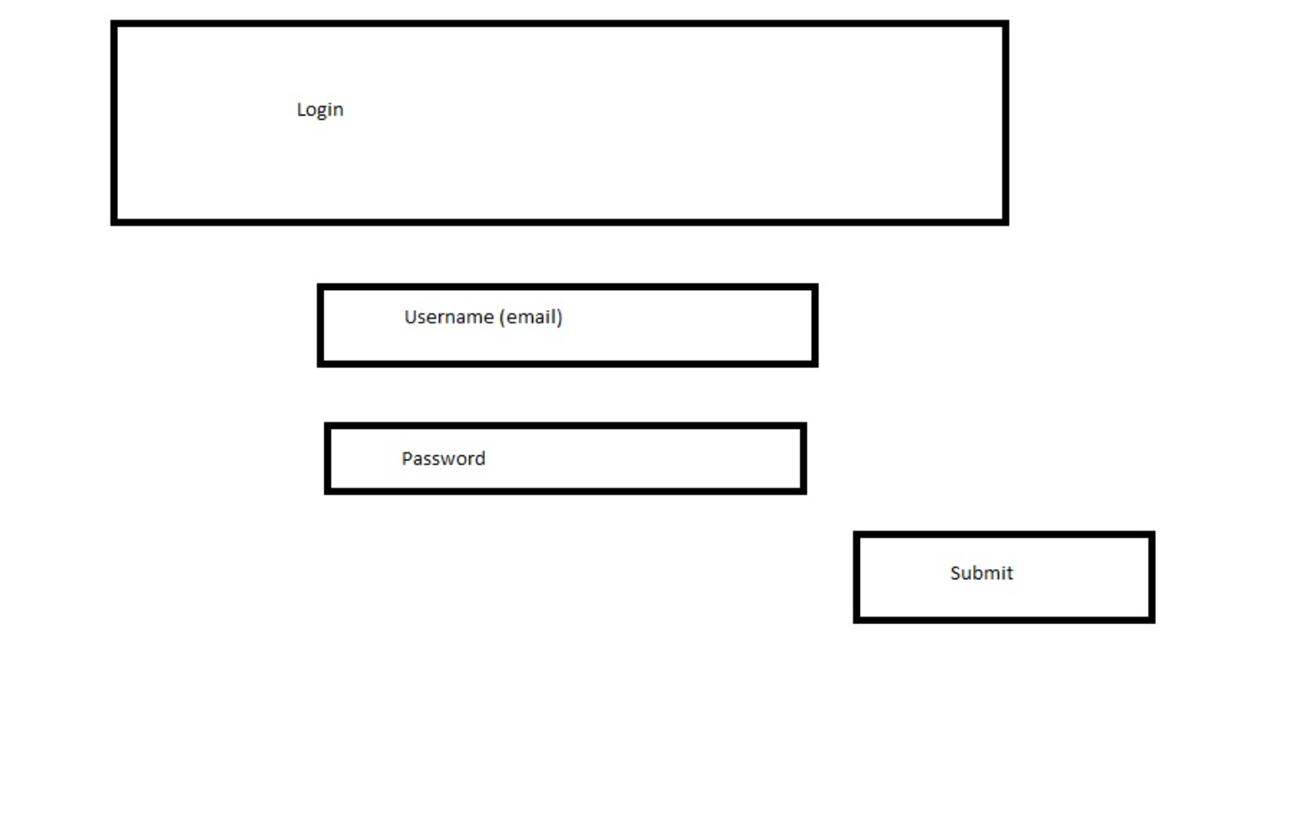
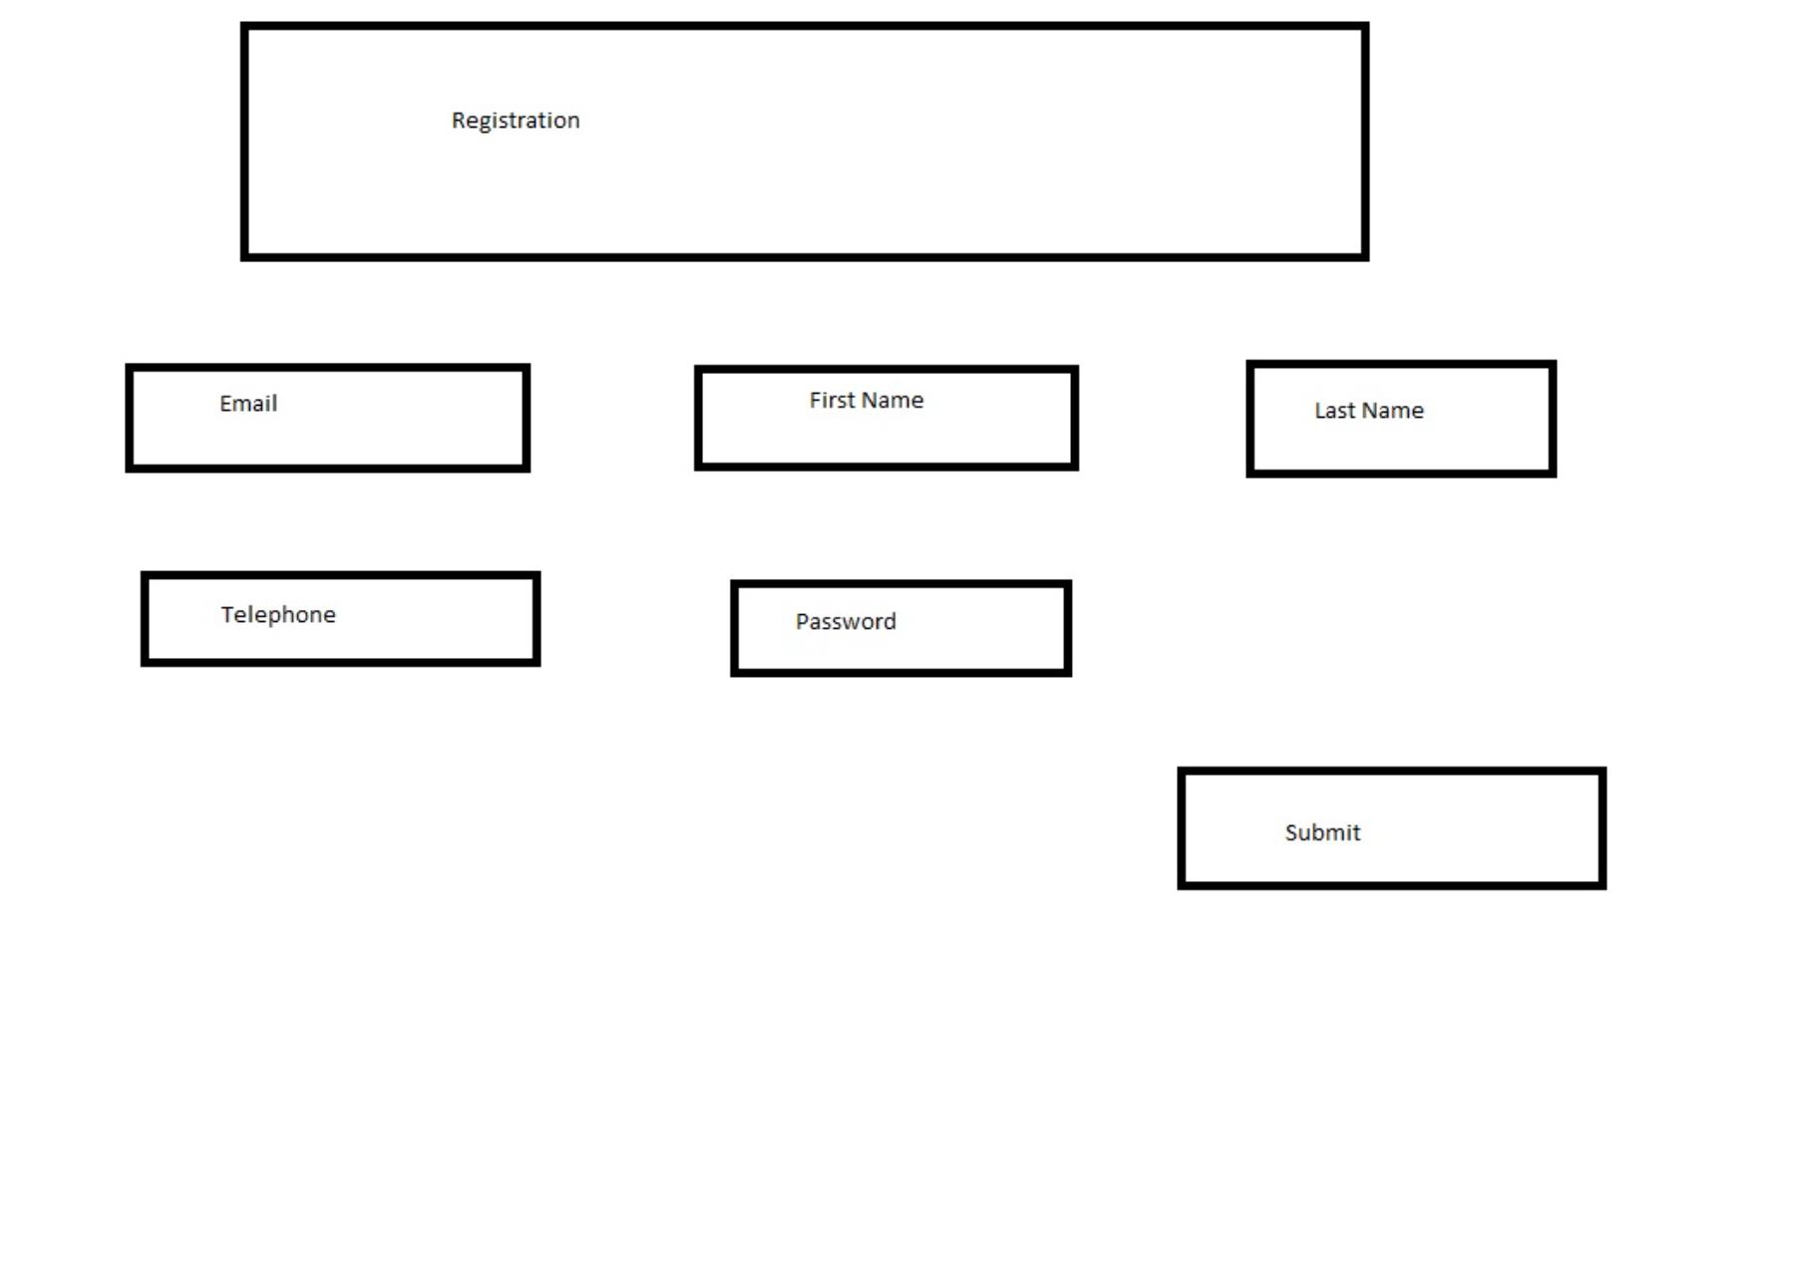
Sample prototypes (cont.)

Slide 6
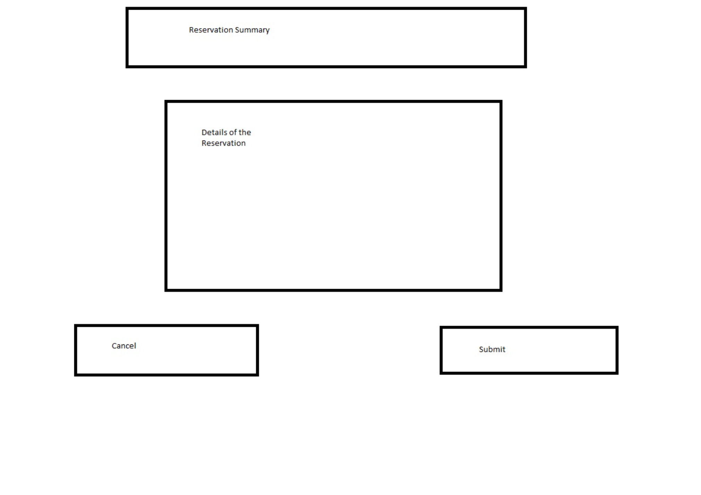
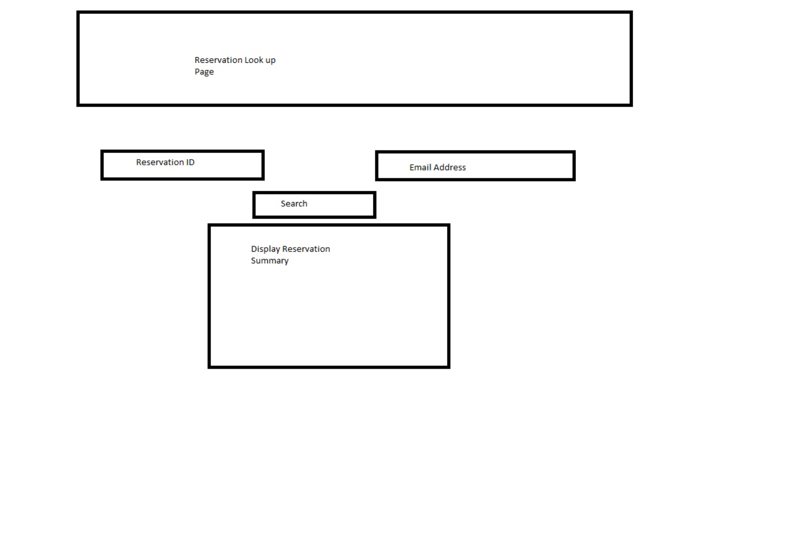
Sample prototypes (cont.)

Slide 7
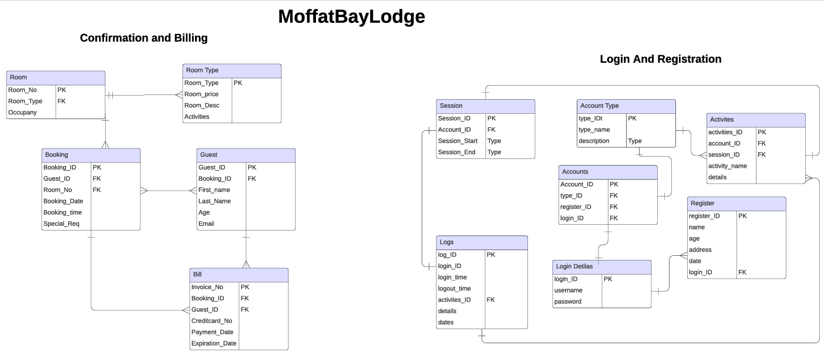
Entity Relationship Diagram (ERD)

Slide 8
Test/Quality Assurance
Links
All links lead to the correct page
Organization
Photos and text are properly spaced throughout the web application
Register
User is able to register
Data is stored on a secure database
Login
User is able to recall login from registration and save their session
Reservation
User can make a reservation and a room with various events
User can recall their reservation and view it once booked.

Slide 9
Lessons learned
Communication is key
Text text text
Organization is king
Text text text
Schedule the work
Text text text

Slide 10
Live site demonstration

Slide 11
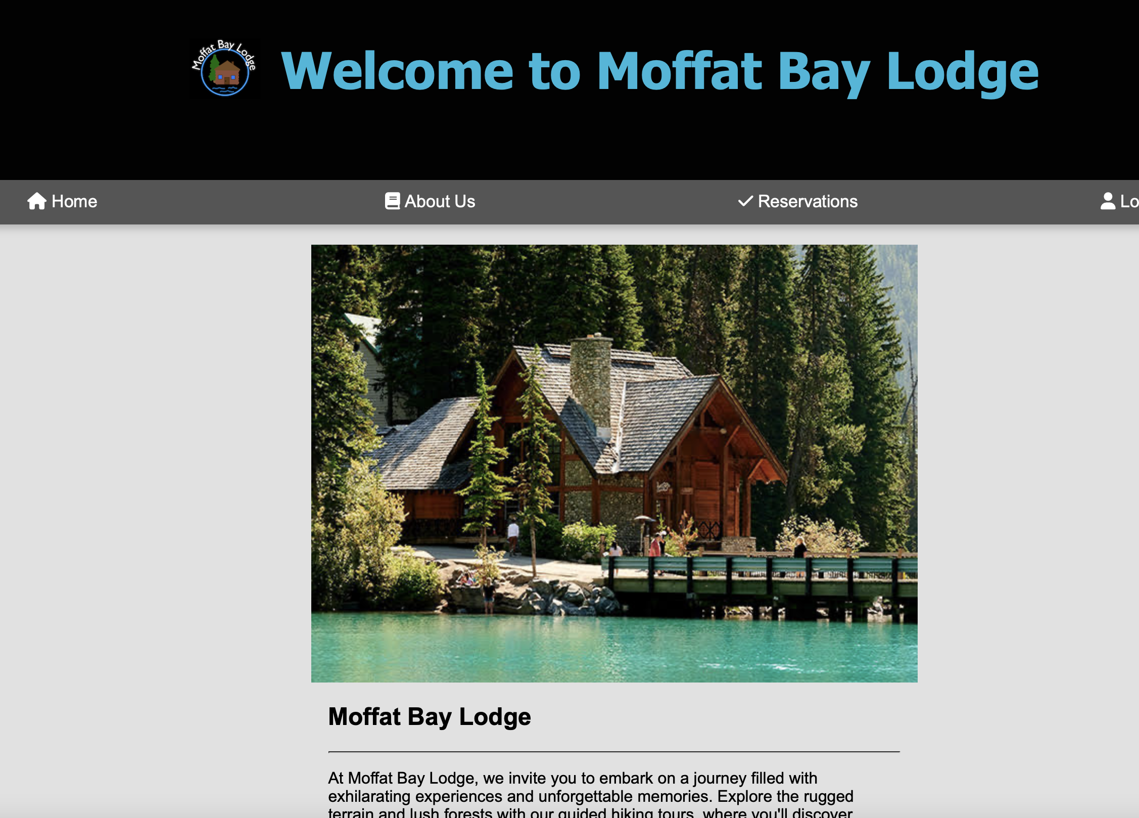
Landing page

Slide 12
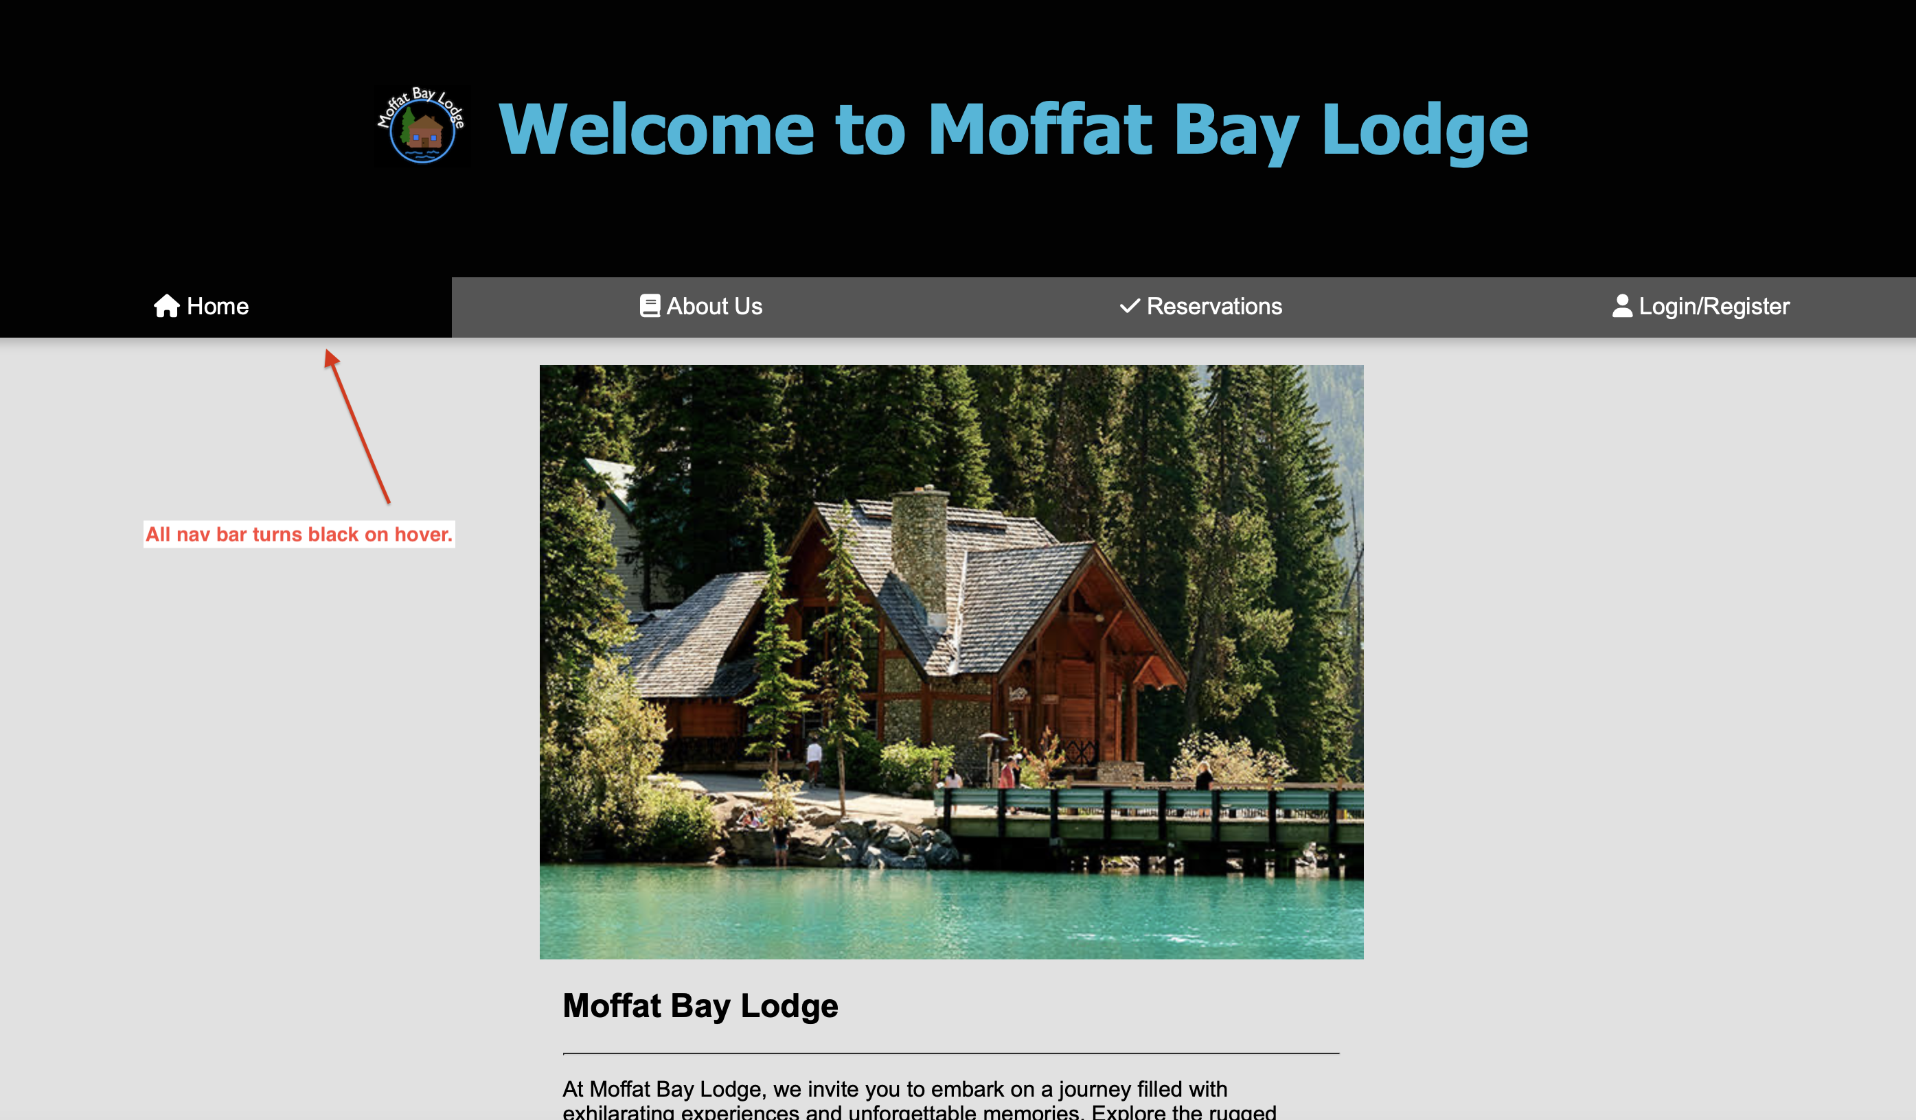
Landing page 2

Slide 13
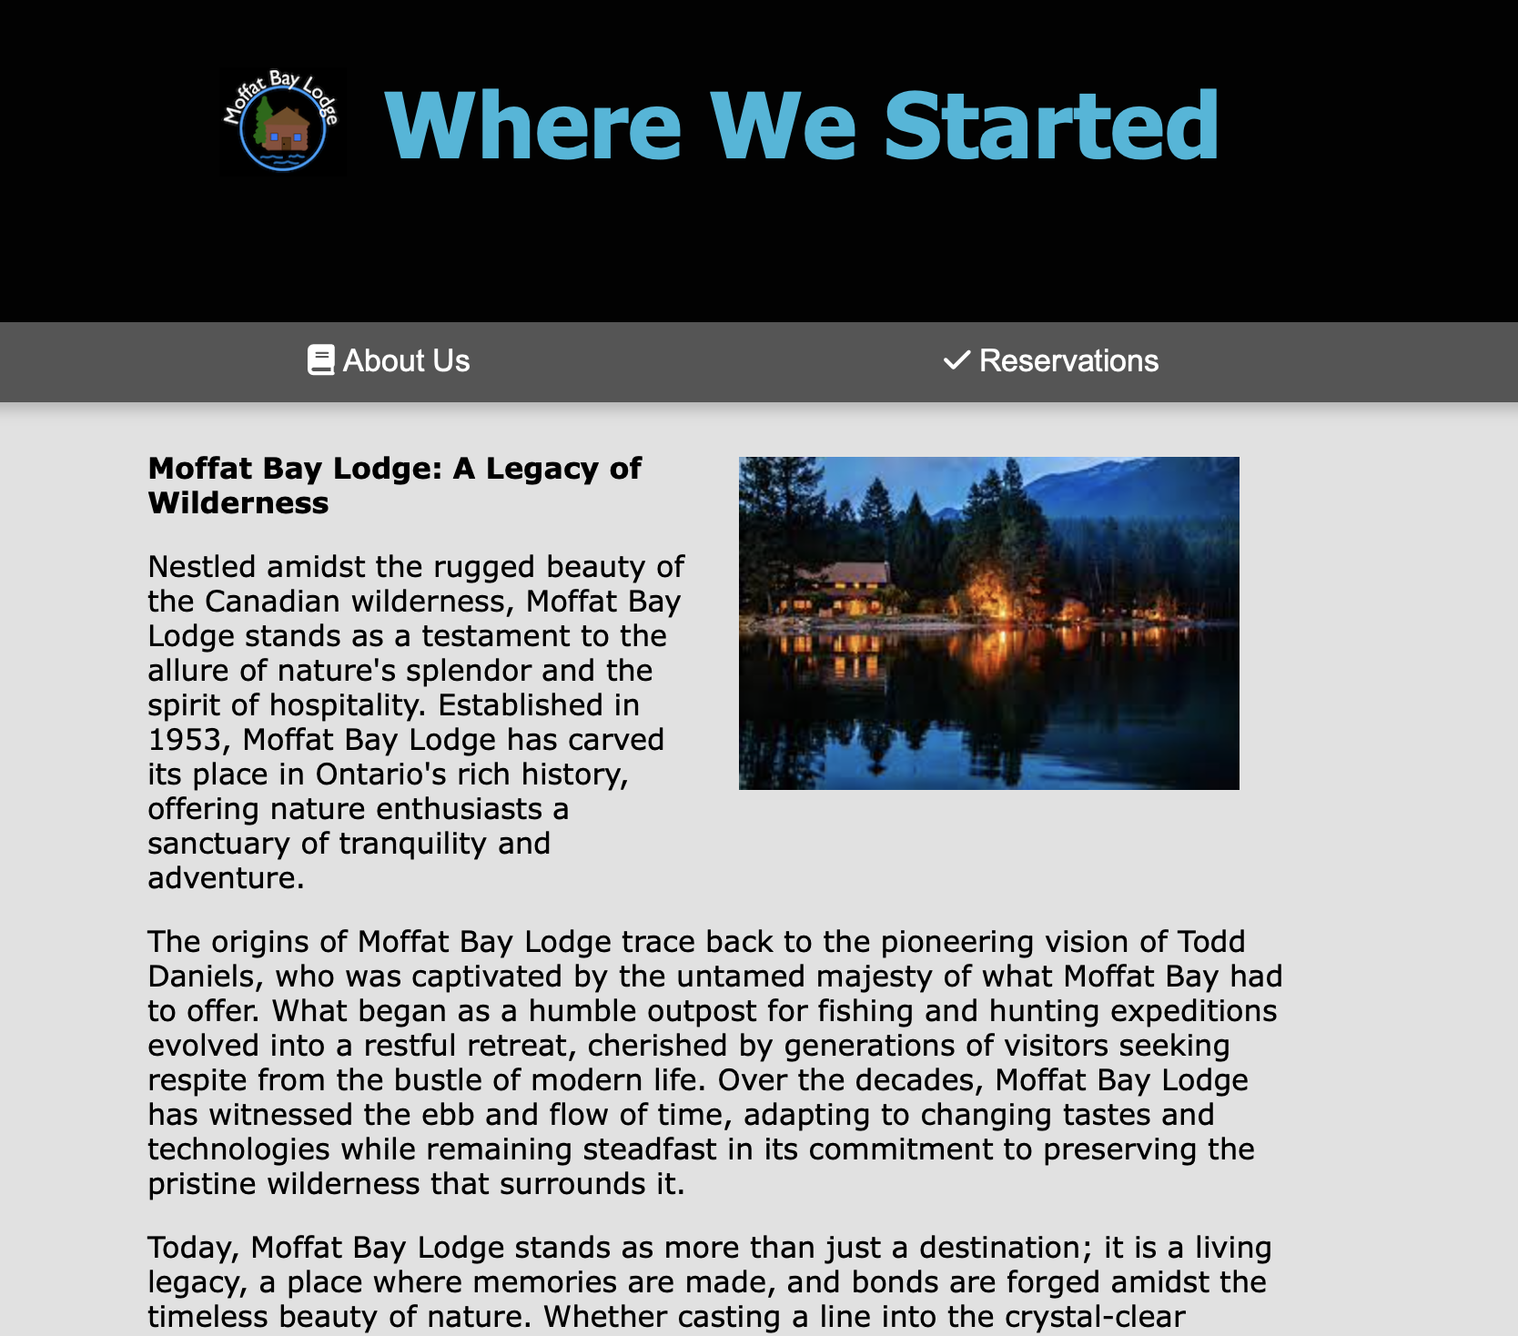
About us (cont.)

Slide 14
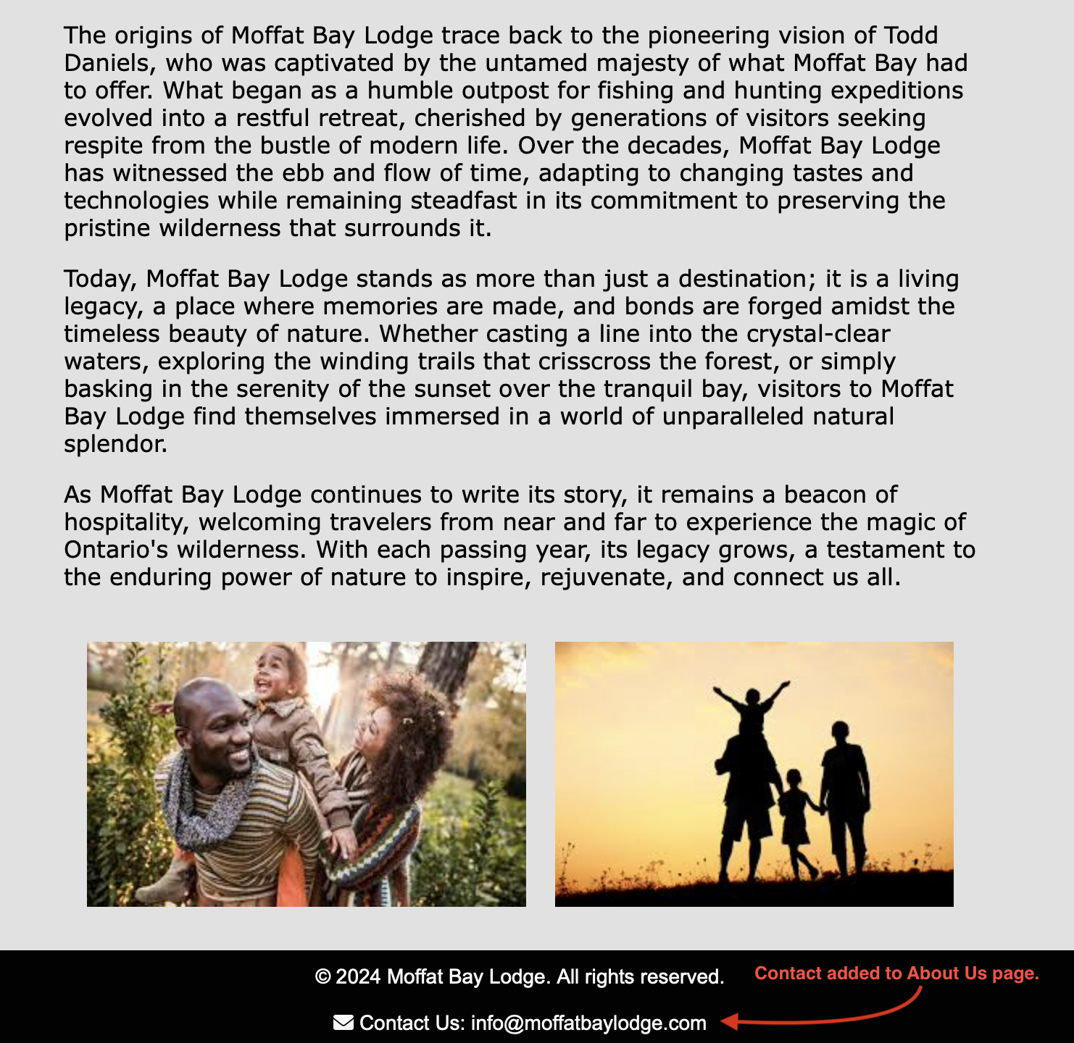
About us (cont.)

Slide 15
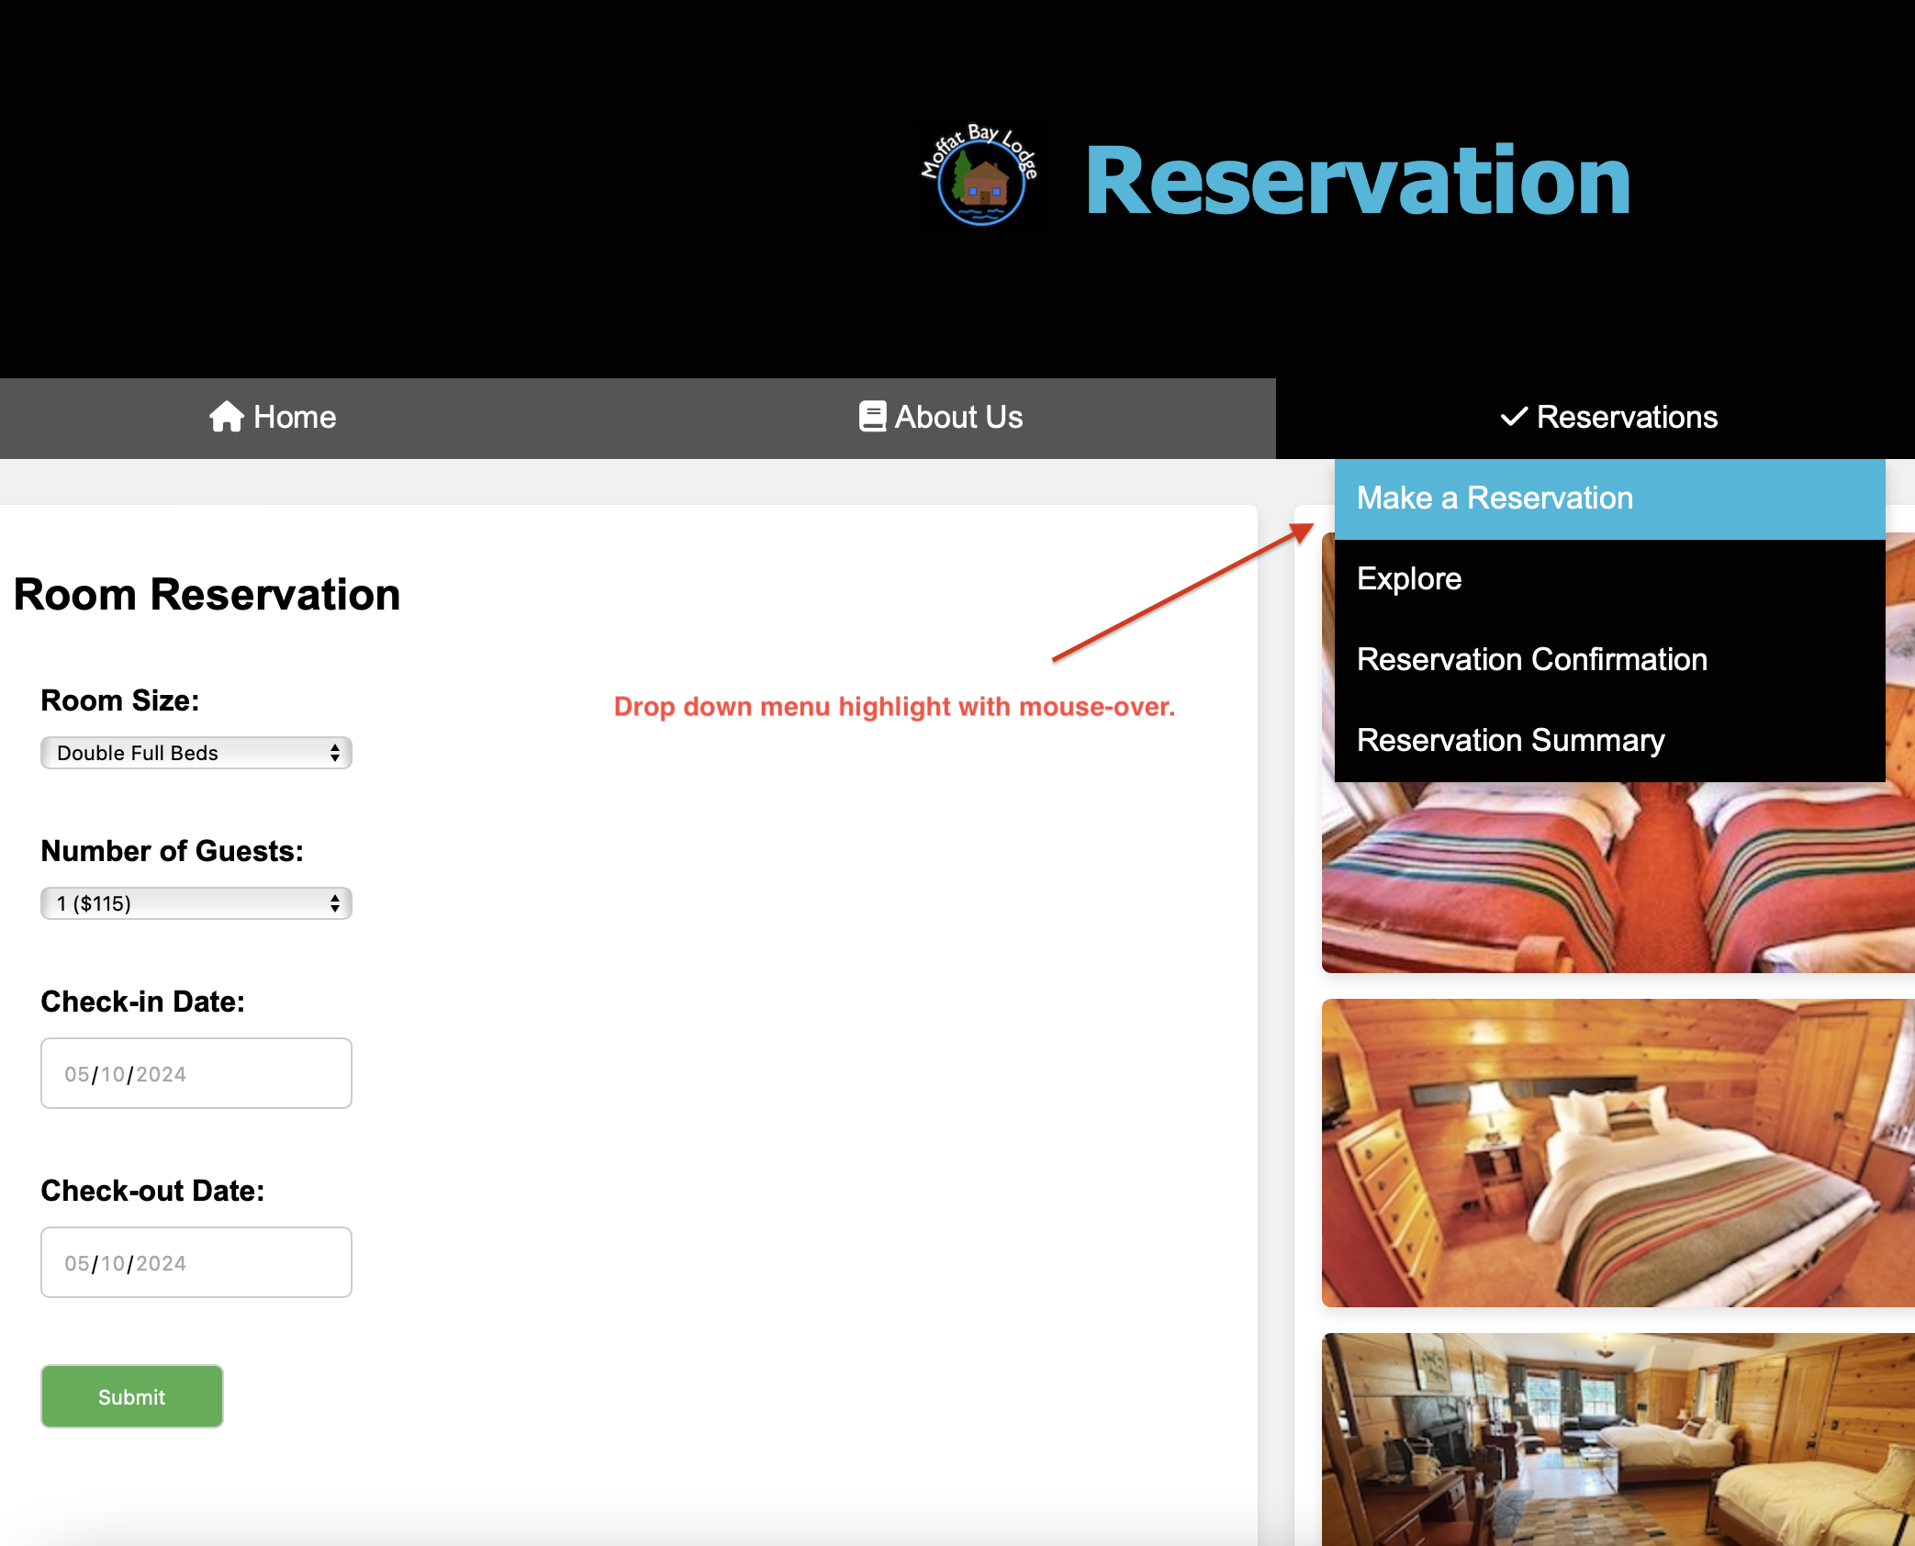
Reservation

Slide 16
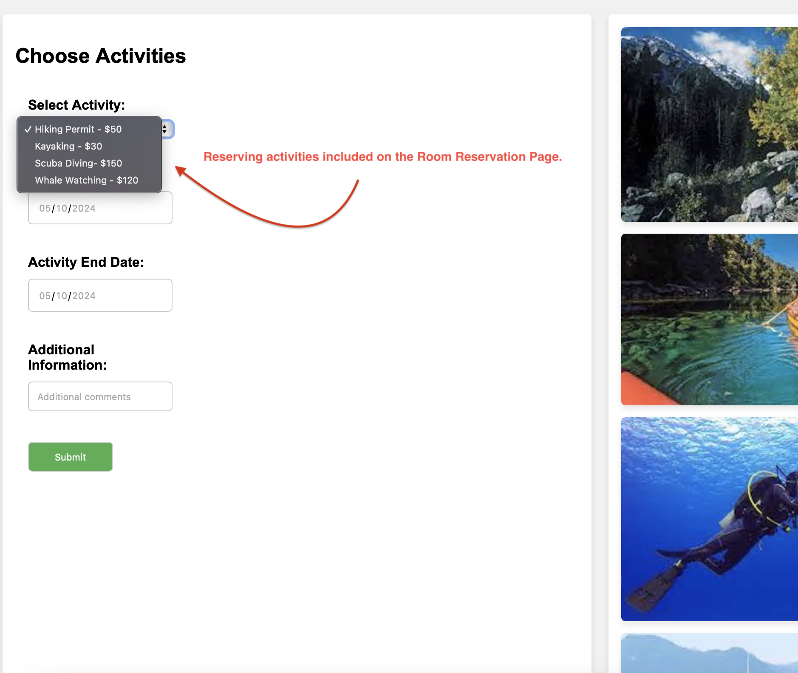
Reservation (cont.)

Slide 17
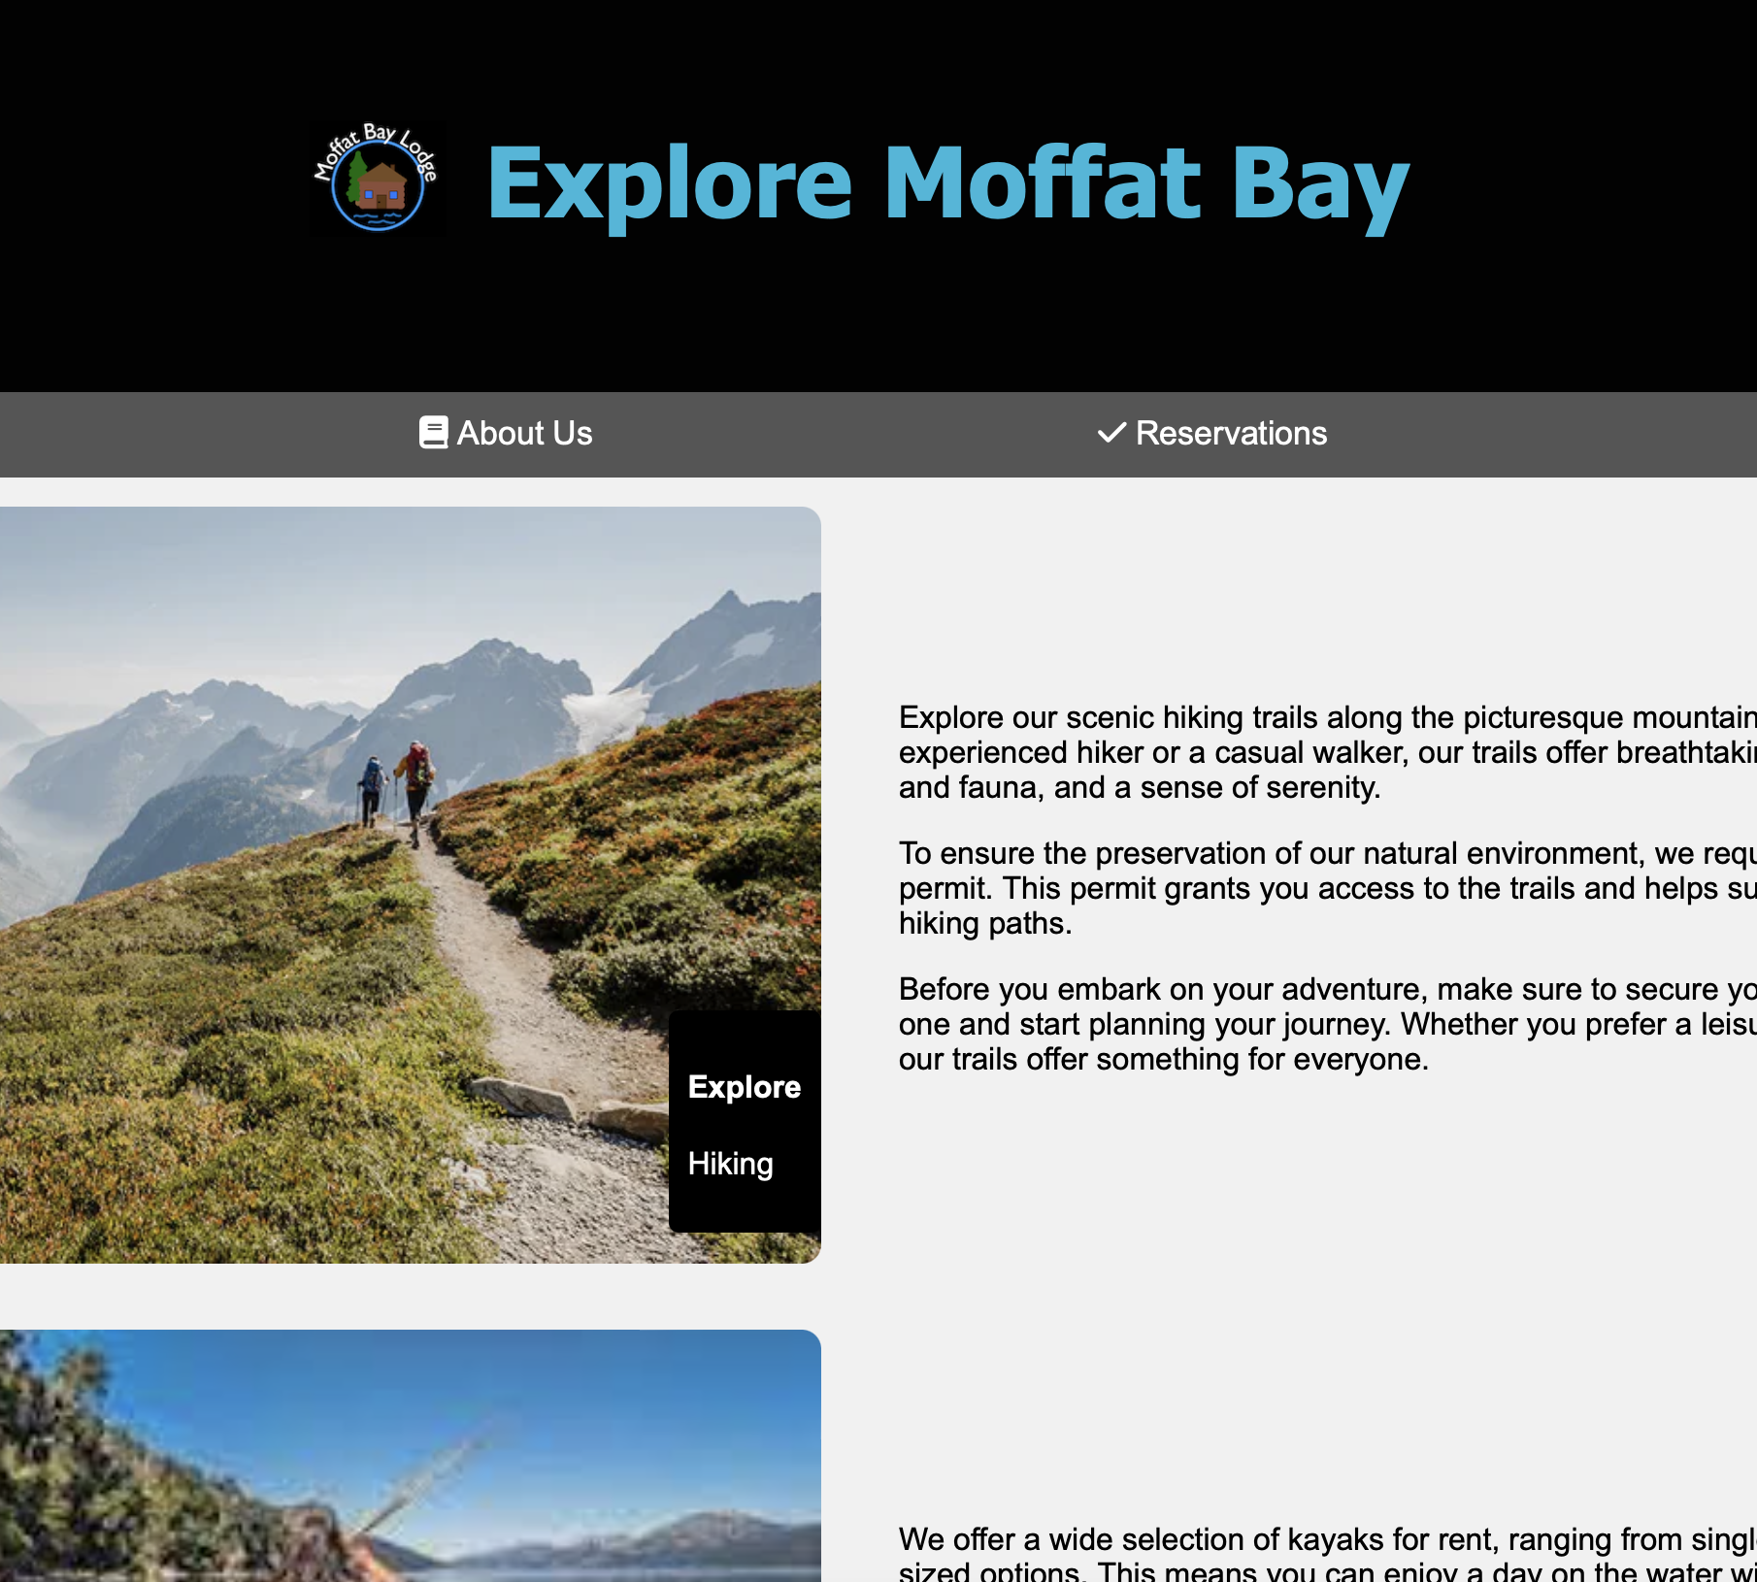
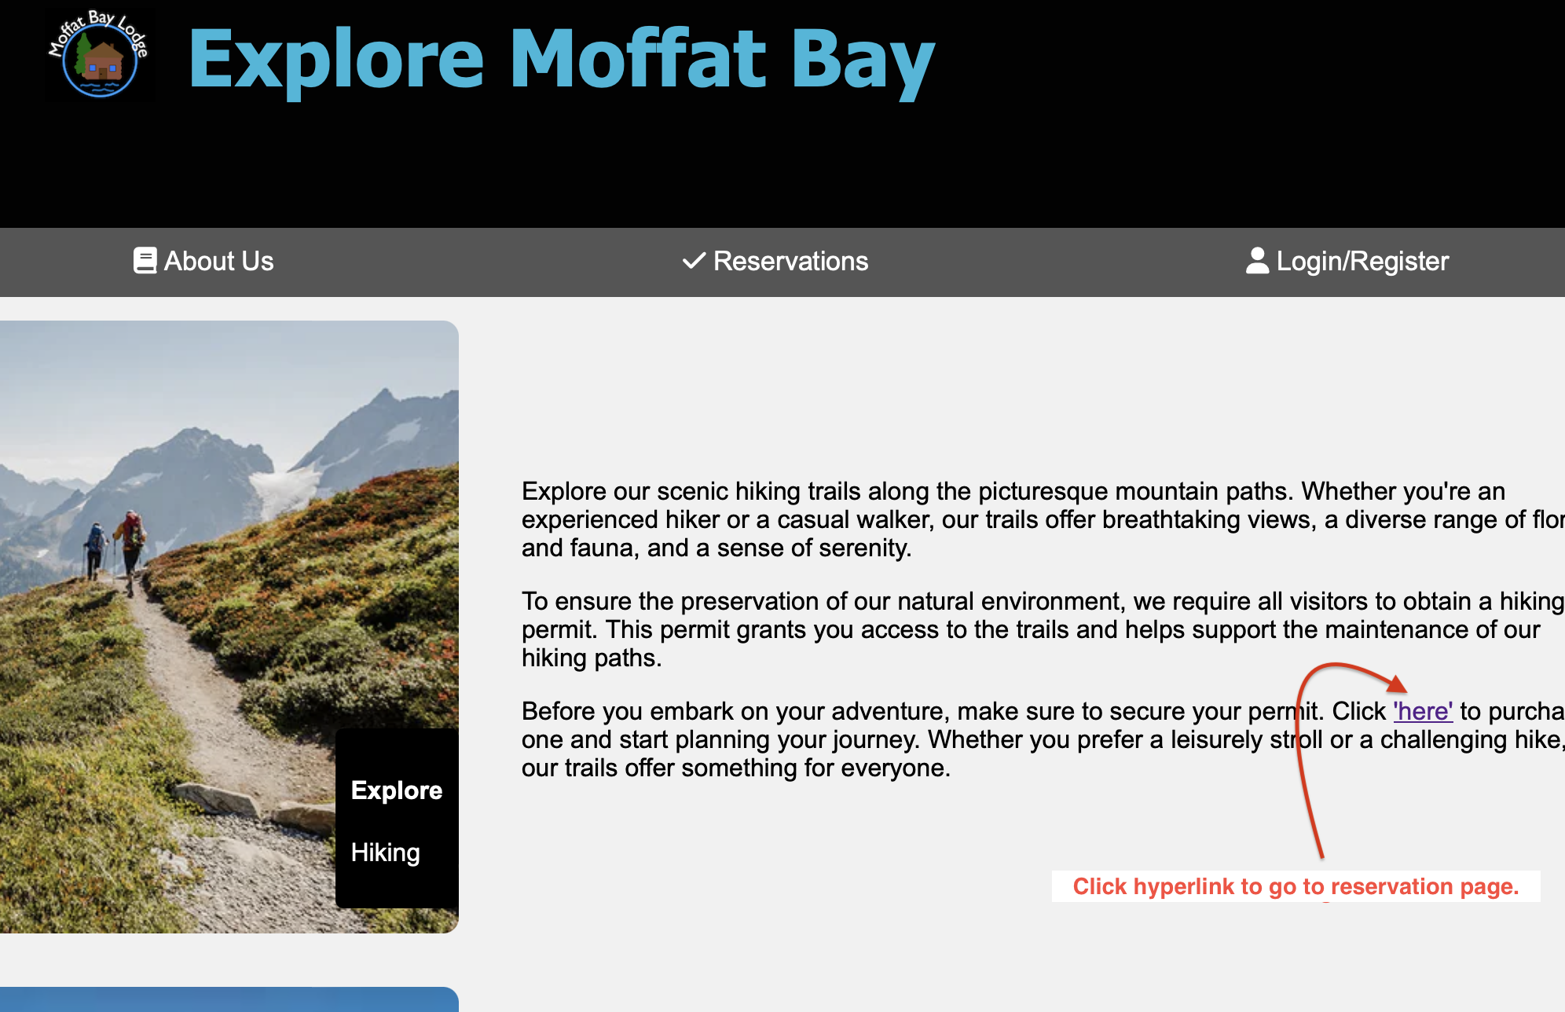
explore

Slide 18
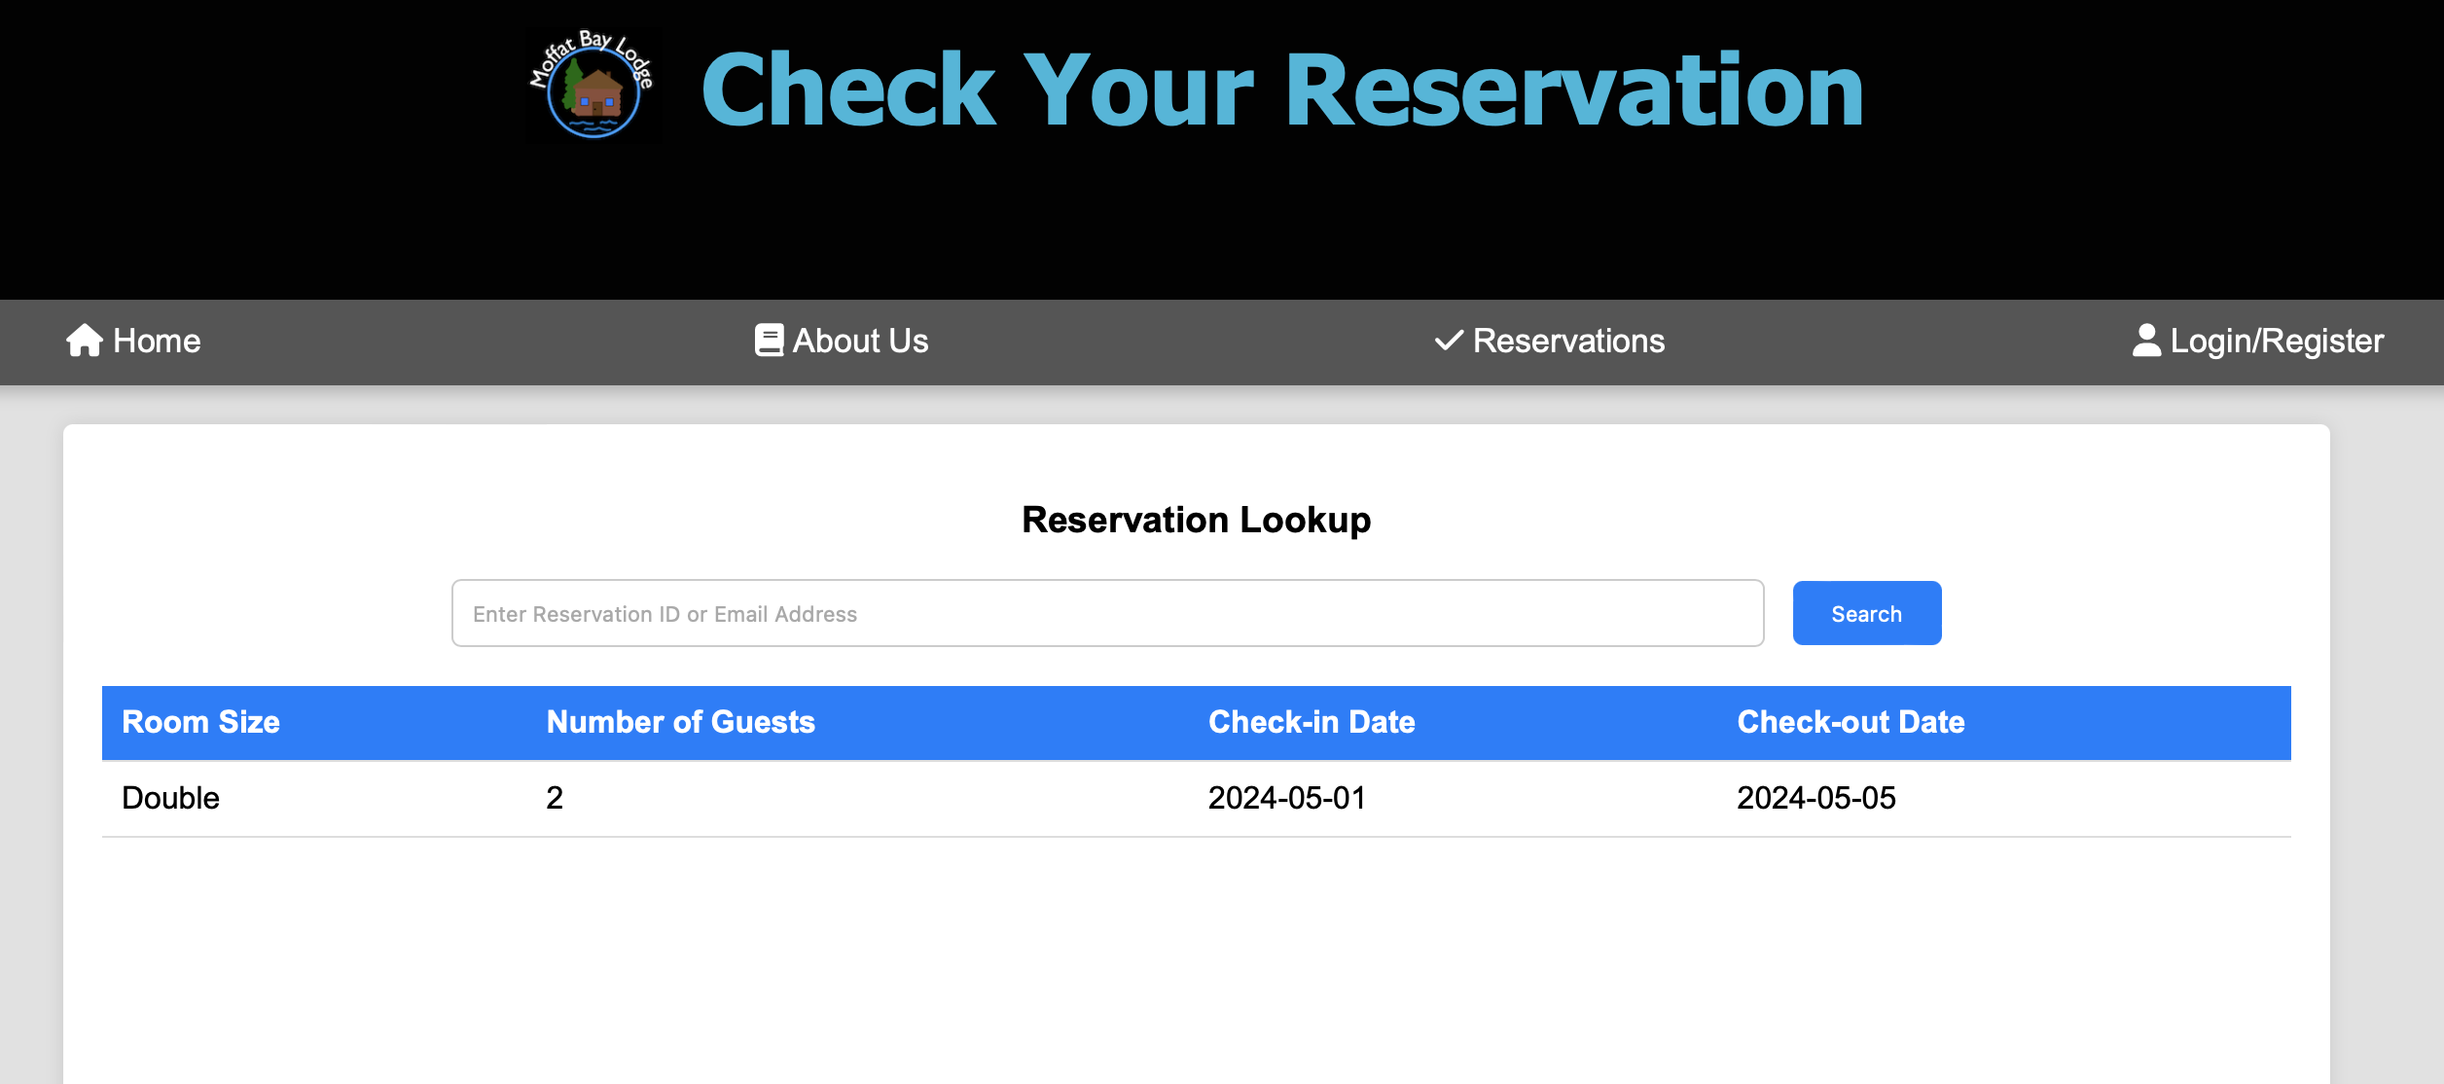
Reservation lookup

Slide 19
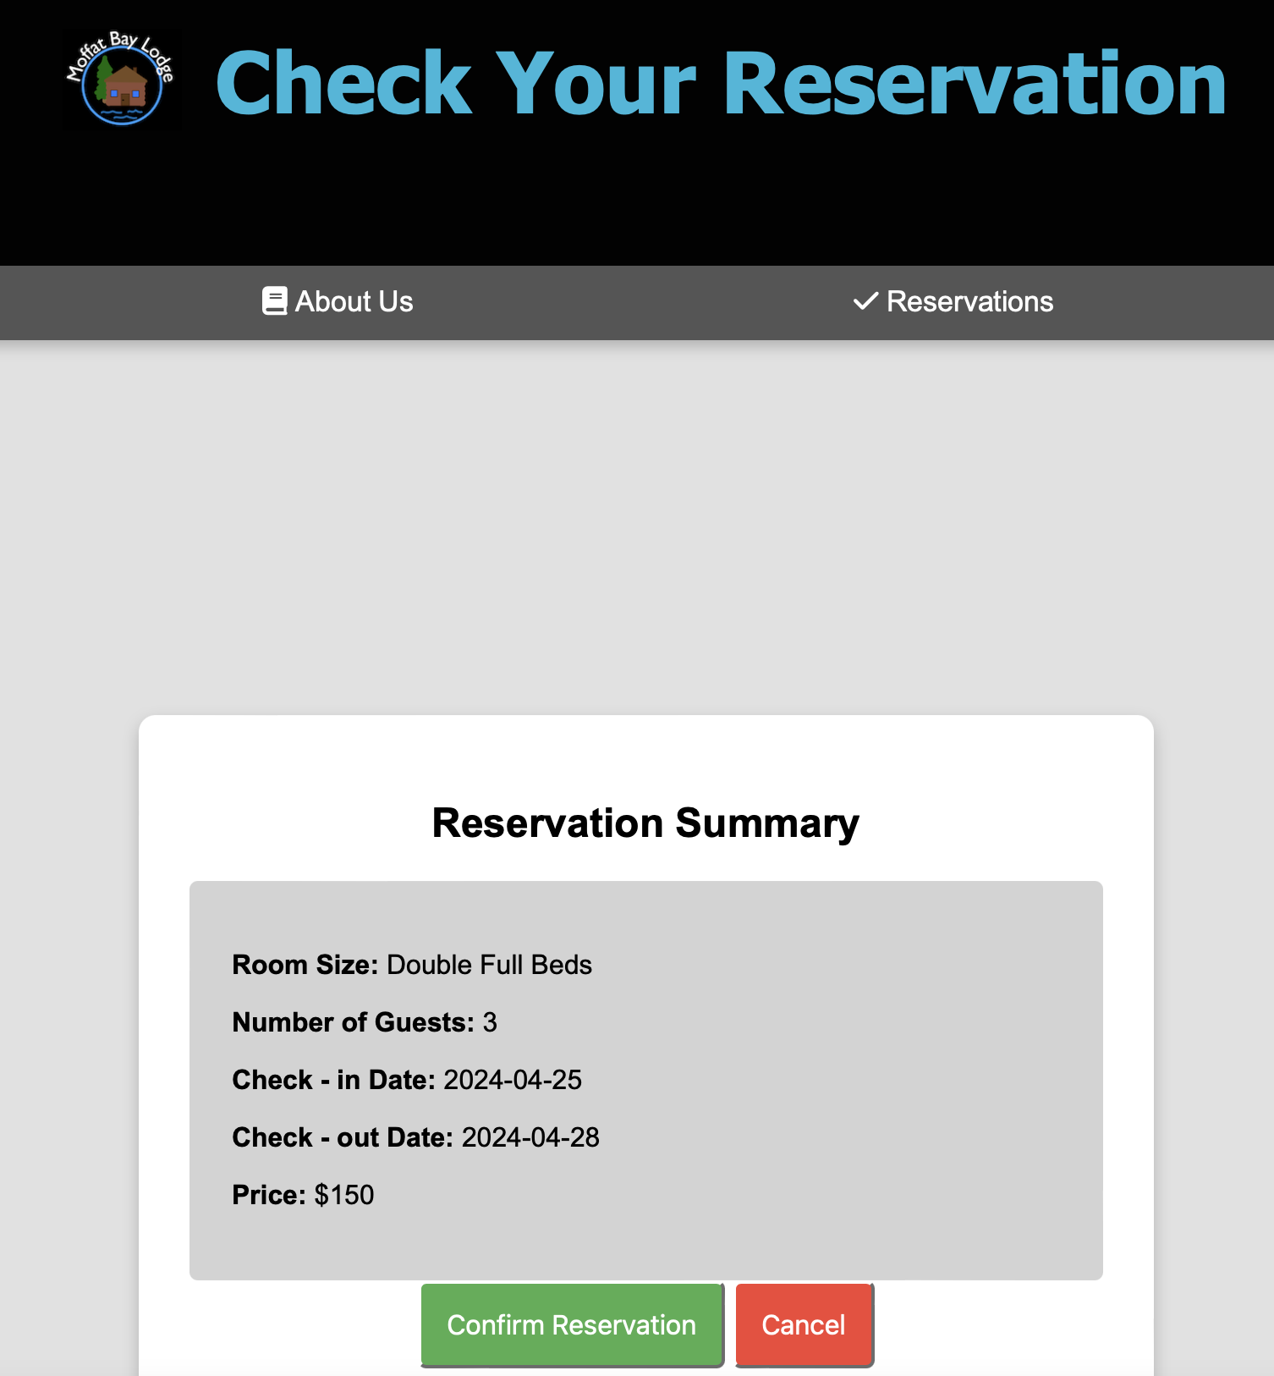
Reservation summary

Slide 20
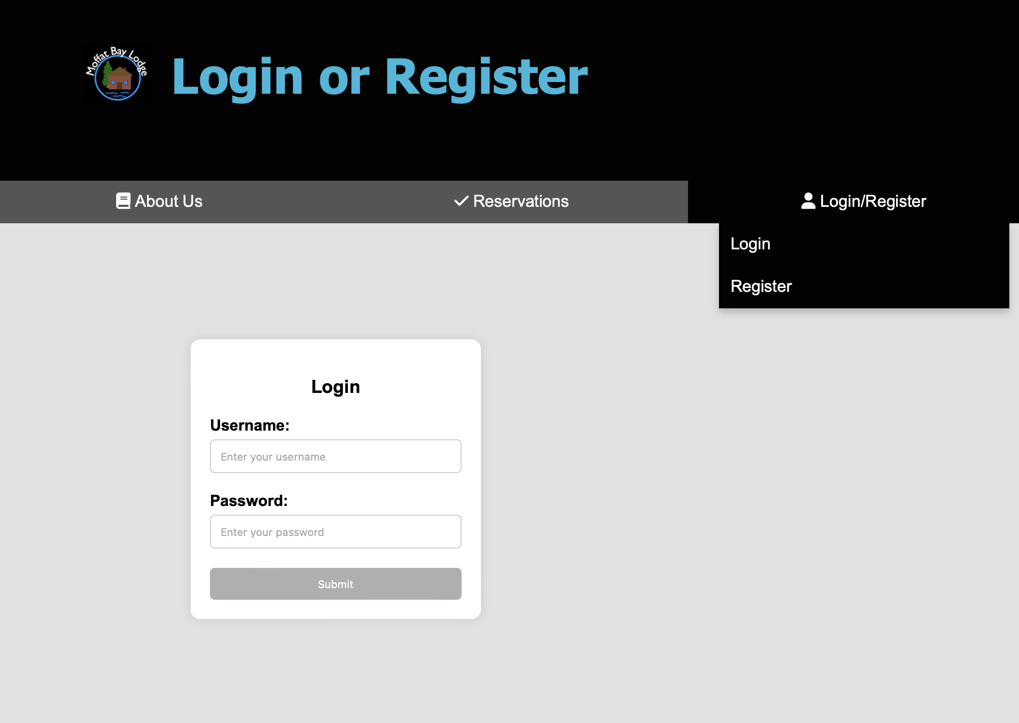
login

Slide 21
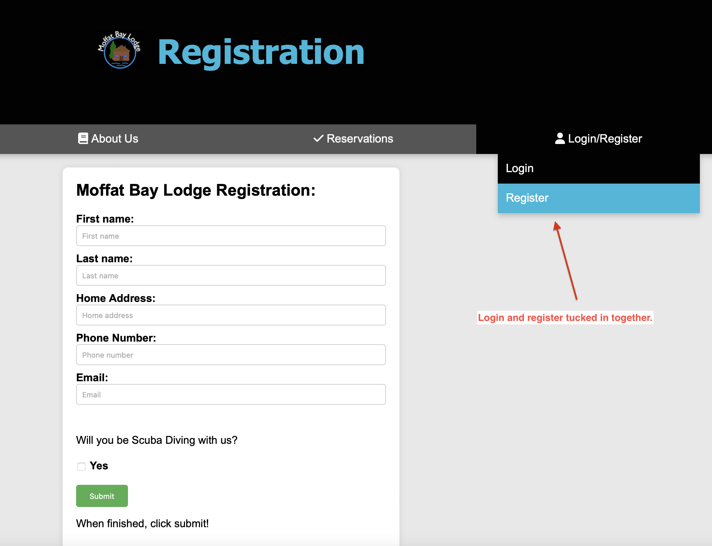
Registration

